Slide 1


HACKER EYE
PARUL INSTITUTE OF ENGINEERING & TECHNOLOGY
FACULTY OF ENGINEERING & TECHNOLOGY
PARUL UNIVERSITY
PRESENTED BY :
PRIYA BANIK(2203031057091) GUIDE : KUNTAM SUTHAR
PAKALAPATI NAGA SURYA(2203031247027)
BADAM SAI SATHWIK(210303124215)
ARUMILLI G S NAVANEETH(210303124202)
PARUL INSTITUTE OF ENGINEERING & TECHNOLOGY, PARUL UNIVERSITY

Slide 2
CONTENT
Introduction
Background study
Objectives of the Project
What is exactly to be done?
Why is this project selected?
Where is the project is helpful?
When it can be implemented?
Who will be benefitted?
Project Team : Roles and Responsibilities
Schedule
UML Diagrams
Advantages of the System
Limitations of the System
Conclusion
Future Work
References
PARUL INSTITUTE OF ENGINEERING & TECHNOLOGY, PARUL UNIVERSITY

Slide 3
INTRODUCTION
By the name Hacker Eye we can get to know that this website keep eye on the user safety to provide security and safety to the user . It is a valuable online website.
Website will provide us the security for accessing URLs and files that will make us know the file or URL malicious present or absent.
The platform allows users to check for viruses that their own antivirus software might have missed or to verify against false positives.
Dynamic Malware Analysis: Website employs the Cuckoo sandbox for dynamic analysis of malware. This process identifies malicious behavior and patterns in suspicious files.
PARUL INSTITUTE OF ENGINEERING & TECHNOLOGY, PARUL UNIVERSITY

Slide 4
Background Study
Sr. number | Paper Title | Publisher | Year | Take-away position
1 | Computer virus strategies and detection methods | Essam AI Daoud, Iqbal Jebril, Belal Zaqaibeh | 2008 | To develop new reliable antivirus software some problems must be solved such as: a new method to detect all metamorphic virus copies, new reliable monitoring techniques to discover the new viruses or attaching a digital signature and a certificate to each new software.
2. | A Study Of Cyber Security Challenges And Its Emerging Trends On Latest Technologies | Nikhita Reddy Gade , Ugander G J Reddy | 2014 | The challenges faced by cyber security on the latest technologies .It also focuses on latest about the cyber security techniques, ethics and the trends changing the face of cyber security.
3. | Malware Analysis and Detection Using Machine Learning Algorithms | Muhammad Shoaib Akhtar , Tao Feng | 2022 | To identify malicious threats or malware, we used a number of machine learning techniques. A high detection ratio indicated that the algorithm with the best accuracy was selected for usage in the system
4. | Understanding malware behaviour through traffic analysis | Qiwei Ke | 2021 | To perform an analysis on the banking trojan TrickBot and understand its traffic behaviour. In order to achieve this, an adequate closed sandbox environment had to be designed and implemented.
PARUL INSTITUTE OF ENGINEERING & TECHNOLOGY, PARUL UNIVERSITY

Slide 5
Objectives Of The Project
HACKER EYE Website is used to identify and scan the URLs and files caring harmful or malicious viruses or not. It shows the output that the files or URLs what we want to check that it safe or not for accessing.
What is exactly to be done?
Hacker Eye website will perform that, it find out the links or Url’s having maliciousness present or not And all also it will detect the duplication of pictures in social-media .
Why is this project selected?
This project is selected because it can help people to find out the safest path for the link they can explore without any data-loss or any other difficulties.
PARUL INSTITUTE OF ENGINEERING & TECHNOLOGY, PARUL UNIVERSITY

Slide 6
Continue..
Where is the project is helpful?
we will provide 3 times free access to the user for accessing the project which is helpful in day-to day environment in today’s world that everyone can perform for their safety or precautions purpose . Later user can access for more that time they have to pay .
When it can be implemented?
Hacker Eye will implement a platform for aggregating antivirus scanning engines to analyze suspicious files and URLs.
Who will be benefitted?
Using this website allows you to quickly scan files and URLs with multiple antivirus engines and tools, providing comprehensive threat detection and enhancing your cybersecurity posture with minimal effort.
PARUL INSTITUTE OF ENGINEERING & TECHNOLOGY, PARUL UNIVERSITY

Slide 7
Project Team : Roles and Responsibilities
Sr. number | Team member | Enrollment number | Role | Responsibility
1. | PRIYA BANIK | 2203031057091 | Frontend & Backend | SEO Project Manager
2. | PAKALAPATI NAGA SURYA | 2203031247027 | Backend | QA Testing
3. | BADAM SAI SATHWIK | 210303124215 | Frontend | UX/UI Designer
4. | ARUMILLI G S NAVANEETH | 210303124202 | Back-end database | DATABASE ENGINEER
PARUL INSTITUTE OF ENGINEERING & TECHNOLOGY, PARUL UNIVERSITY

Slide 8
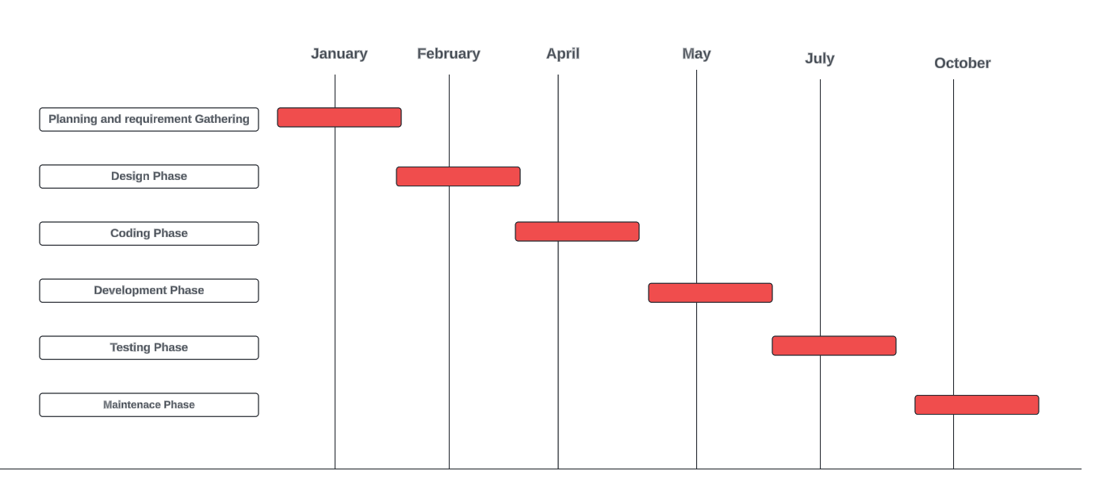
Time Line Chart - Schedule
PARUL INSTITUTE OF ENGINEERING & TECHNOLOGY, PARUL UNIVERSITY

Slide 9
Technology
Frontend Technology:-
HTML
CSS
JavaScript
Backend Technology:-
Language :- Python(Flask), JAVA
Programming Language: Machine Learning
Database:- MongoDB(NoSql) or PostgreSQL
PARUL INSTITUTE OF ENGINEERING & TECHNOLOGY, PARUL UNIVERSITY

Slide 10
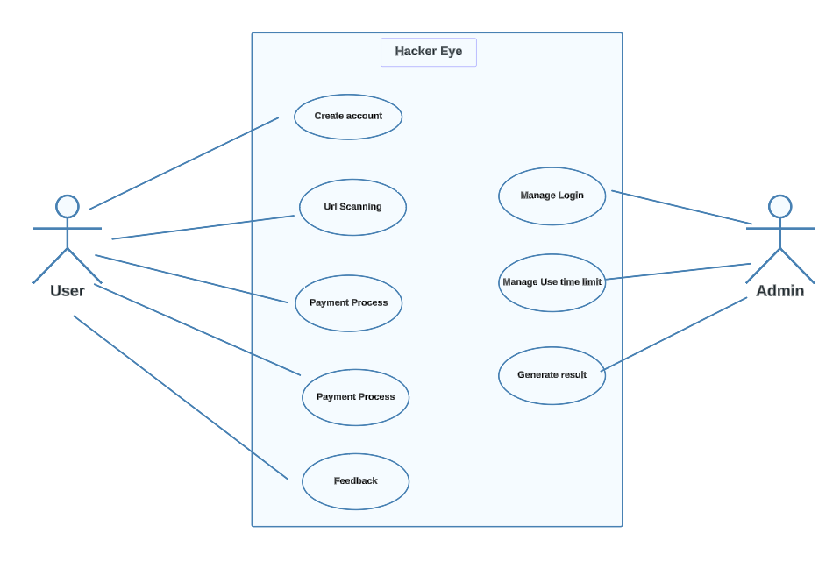
UML: Use-Case Diagram
PARUL INSTITUTE OF ENGINEERING & TECHNOLOGY, PARUL UNIVERSITY

Slide 11
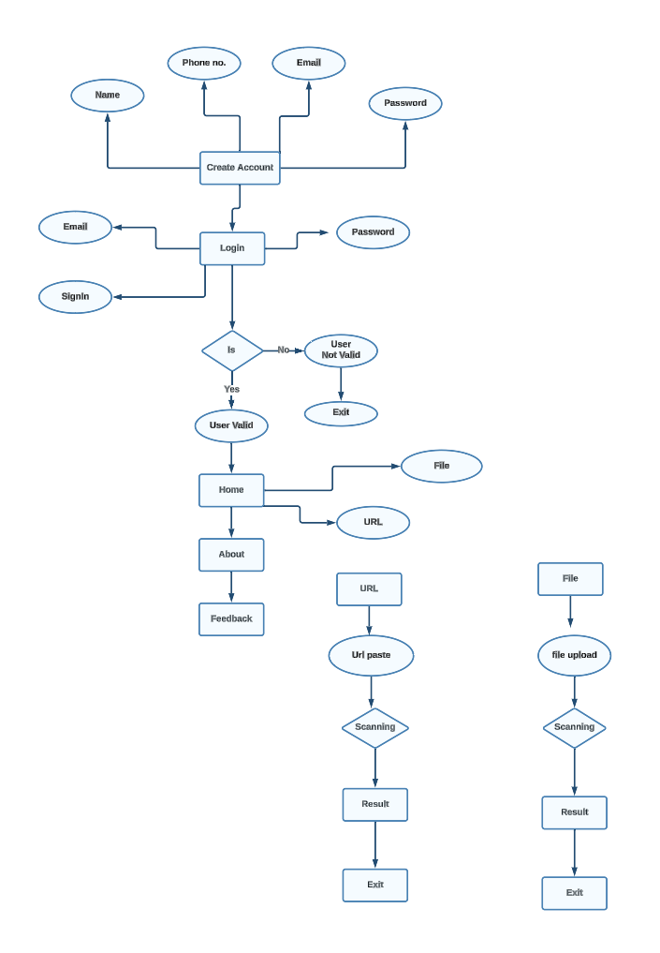
Entity Relationship Diagram
PARUL INSTITUTE OF ENGINEERING & TECHNOLOGY, PARUL UNIVERSITY

Slide 12
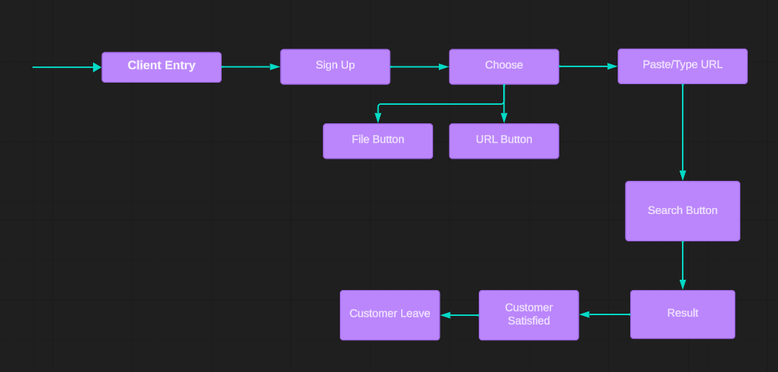
Flow Diagram
PARUL INSTITUTE OF ENGINEERING & TECHNOLOGY, PARUL UNIVERSITY

Slide 13
Hardware Requirement
Requirement | Minimum | Recommended
OS | 64-bit Microsoft Windows 11 | Latest 64-bit version of Windows
RAM | 8 GB RAM | 16 GB RAM or more
CPU | x86_64 CPU architecture; 3rd generation Intel Core or newer, or AMD CPU with support for a Windows Hypervisor Framework. | Latest Intel Core processor
Disk space | 8 GB (IDE and Android SDK and Emulator) | Solid state drive with 16 GB or more
Screen resolution | 1280 x 800 | 1920 x 1080
PARUL INSTITUTE OF ENGINEERING & TECHNOLOGY, PARUL UNIVERSITY

Slide 14
Software Requirement
VISUAL STUDIO CODE Mongo DB Jupyter notebook Notepad
PARUL INSTITUTE OF ENGINEERING & TECHNOLOGY, PARUL UNIVERSITY

Slide 15
Advantages
This website used to provide benefit to the user before accessing the files or URLs.
Providing 3 times free uses .because other websites will cost us for every single time use and they will not provide any free service.
After completion it will be applicable for customers when they will take subscription for future use .
Easy to Access.
Provide security and safety to the user.
PARUL INSTITUTE OF ENGINEERING & TECHNOLOGY, PARUL UNIVERSITY

Slide 16
Limitation of the System
This website can be access only when user will create account in the website.
Multiple time access can make the system slow.
It is available for free of cost only for three times for single user.
Malicious actors continually evolve their techniques. A detection system may struggle to keep up with new and sophisticated threats, requiring constant updates and improvements.
PARUL INSTITUTE OF ENGINEERING & TECHNOLOGY, PARUL UNIVERSITY

Slide 17
Conclusion
Hacker Eye website is very useful for a user for detecting and analying which URLs of file is safe to access.
Hence, by using this website, we can know the link is safe or not.
PARUL INSTITUTE OF ENGINEERING & TECHNOLOGY, PARUL UNIVERSITY

Slide 18
Future work
Have to update new features.
New design of the website.
Adding more and new antiviruses in the website.
PARUL INSTITUTE OF ENGINEERING & TECHNOLOGY, PARUL UNIVERSITY

Slide 19
Reference
Microsoft Bing AI
Chatgpt AI
Malware Analysis and Detection Engineering by Abhijit Mohanta, Anoop Saldanha
Introduction to cyber security: Guide to the World of Cyber Security by Anand Shinde.
PARUL INSTITUTE OF ENGINEERING & TECHNOLOGY, PARUL UNIVERSITY

Slide 20

PARUL INSTITUTE OF ENGINEERING & TECHNOLOGY, PARUL UNIVERSITY

